Slide 1
CS232 (Computer Networking)
Lobna Osailan 4110171
Yosra Osailan 4110212
Samar Alqurinees 4112149
Instructor name: Ms.Budoor

Slide 2
INTRODUCTION
The provided code is a basic implementation of a client-server chat system using sockets in Python. The server runs on a specified IP address and port, listening for incoming connections from multiple clients. The clients can connect to the server using the server IP address and port number. Once connected, the clients can exchange messages with each other through the server.

Slide 3
Functionality:
The code consists of two Python files: server.py and client.py. The server.py file contains the code to start and run the server, while the client.py file contains the code for connecting to the server as a client.
The server.py file first creates a socket object and binds it to a specified IP address and port number. The server then listens for incoming connections and adds them to a list of clients. When a new client joins, the server prompts them to enter a nickname, which is used to identify them in the chat. The server then broadcasts messages to all connected clients whenever a message is received from any client.

Slide 4
The client.py file prompts the user to enter their nickname and the IP address of the server they want to connect to. Once the client is connected, it sends its nickname to the server and starts two threads: one for receiving messages from the server and another for sending messages to the server. The receiving thread continuously listens for incoming messages from the server and prints them to the console. The sending thread prompts the user to enter a message and sends it to the server in the format "nickname: message".

Slide 5
Explanation:
The code uses the Python socket library, which provides a low-level interface for network communication. The server and client communicate with each other using TCP sockets, which provide reliable, ordered, and error-checked delivery of data between applications running on different hosts. The server uses a list to keep track of connected clients and their nicknames. When a new client connects, the server adds the client socket object to the list and prompts the client to enter a nickname. The nickname is stored in a separate list to keep track of the nicknames of all connected clients. Whenever a message is received from a client, the server broadcasts the message to all connected clients by iterating through the list of client sockets and sending the message to each one.

Slide 6
The client prompts the user to enter their nickname and the IP address of the server they want to connect to. The client then creates a socket object and connects to the server using the provided IP address and port number. Once connected, the client sends its nickname to the server and starts two threads: one for receiving messages and another for sending messages. The receiving thread listens for incoming messages from the server and prints them to the console. The sending thread prompts the user to enter a message and sends it to the server in the format "nickname: message".

Slide 7
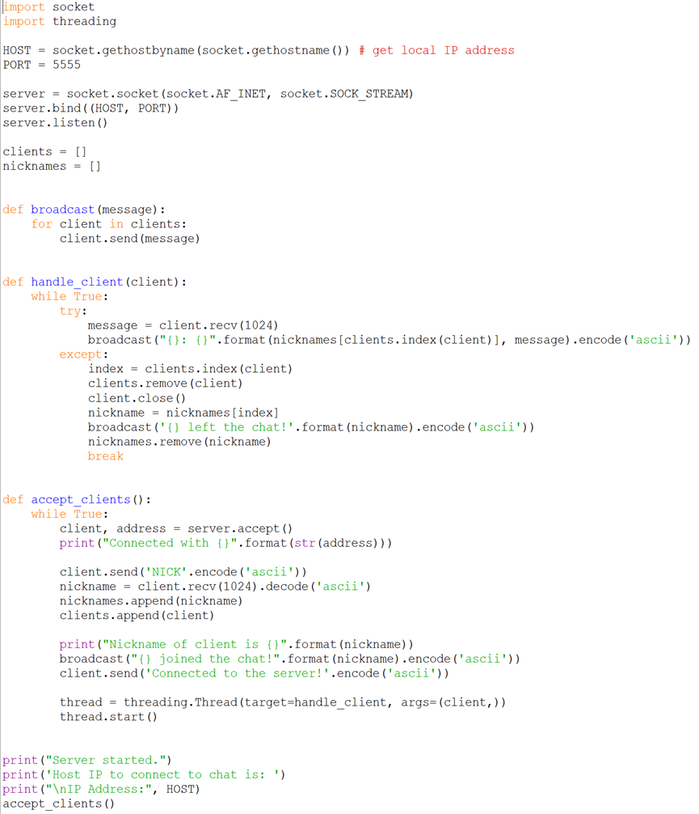
Server code:

Slide 8
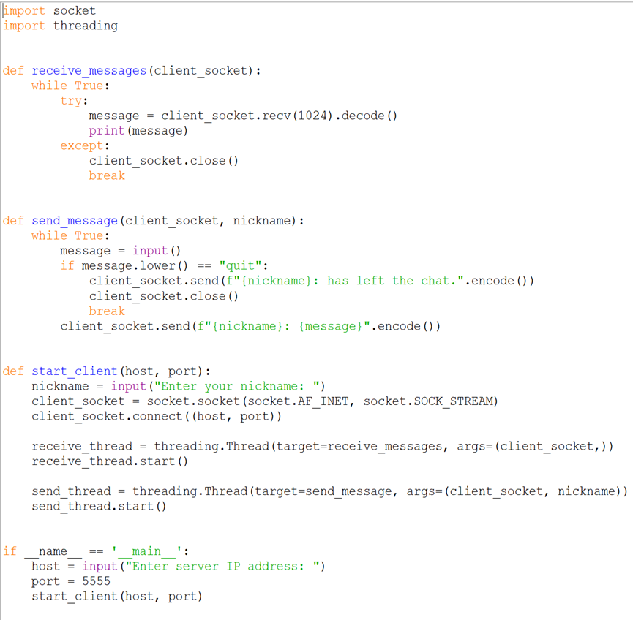
User Code:

Slide 9
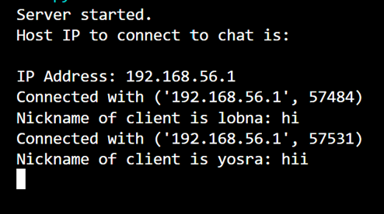
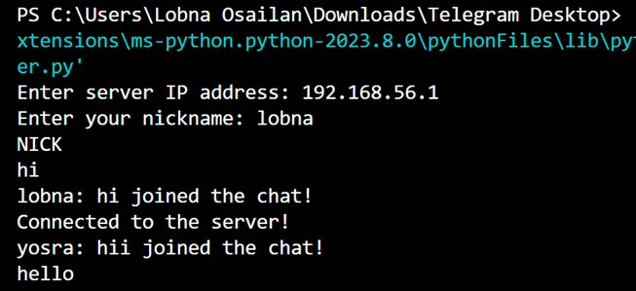
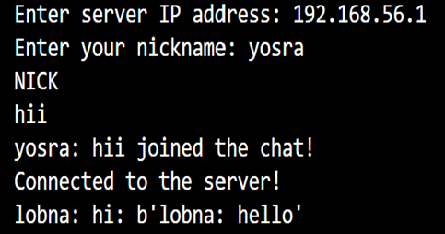
Running server
Running User:
Running User2

Slide 10
Conclusion:
The provided code is a basic implementation of a client-server chat system using sockets in Python. It demonstrates the use of the socket library for network communication and provides a starting point for building more complex chat systems. However, it should be noted that the code is not production-ready and lacks important features such as encryption and authentication. Therefore, it should not be used in production environments without significant modifications and testing.

Slide 11
The End
Thank You for Listening

